Slide 1
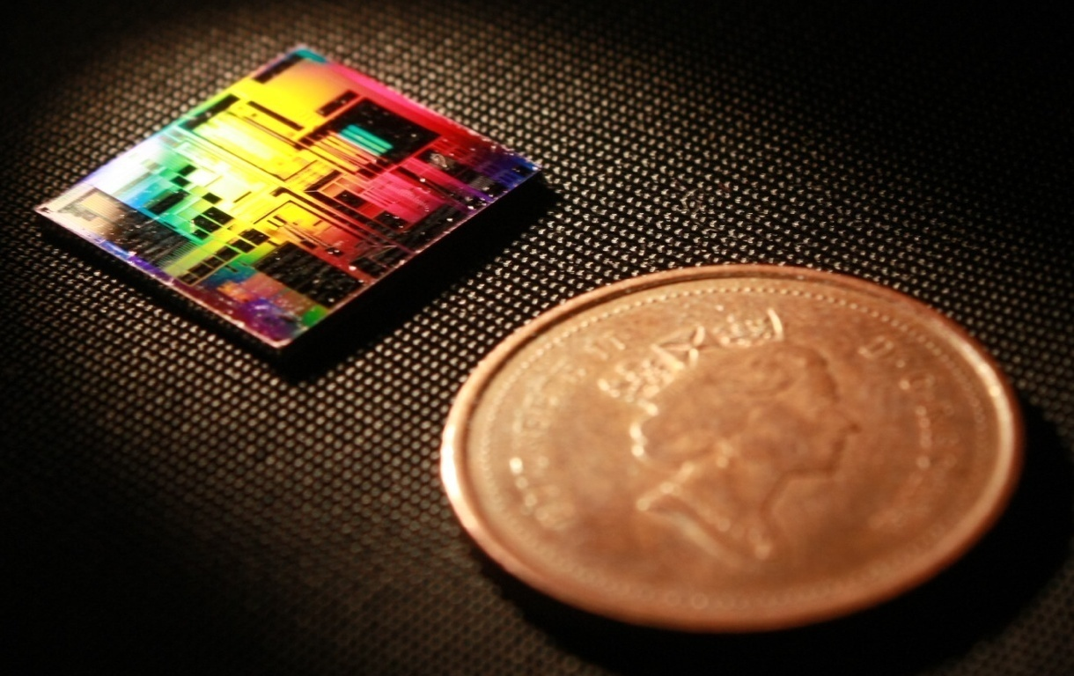
Design of Silicon Photonic Bragg Grating Devices Vancouver, BC, Canada 25 May 2020
Mustafa Hammood,
The University of British Columbia, Vancouver

Slide 2
Outline
Bragg gratings:
Motivation and application
Theoretical approach: Transfer-Matrix Method (TMM)
Theoretical approach: Coupled-mode theory (CMT)
Simulation: Lumerical EME
Simulation: Lumerical 3D/2D FDTD
Simulation: Lumerical FDTD Band-structure
Contra-directional couplers:
Motivation and application
Simulation flow

Slide 3
Bragg Gratings: References
Bragg gratings and contra-directional couplers tutorial: https://www.youtube.com/watch?v=jr3NcJsKvTI
SiEPIC PDK KLayout integration of Bragg Gratings: https://www.youtube.com/watch?v=h2MOOhsuYpA
SiEPIC PDK KLayout integration of Contra-directional couplers: https://www.youtube.com/watch?v=aqocwLcqC0s
and
https://www.youtube.com/watch?v=-vWspXuu8I0

Slide 4
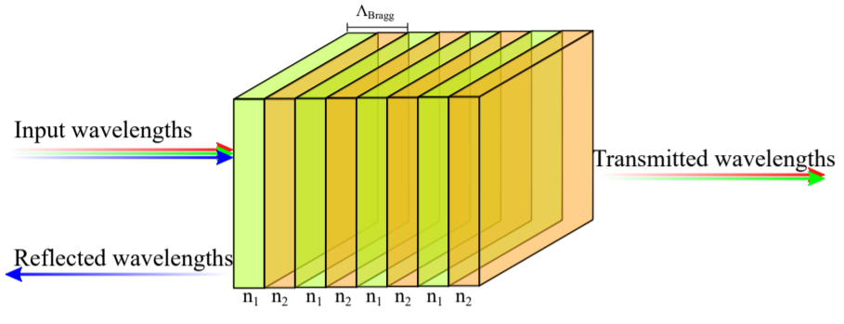
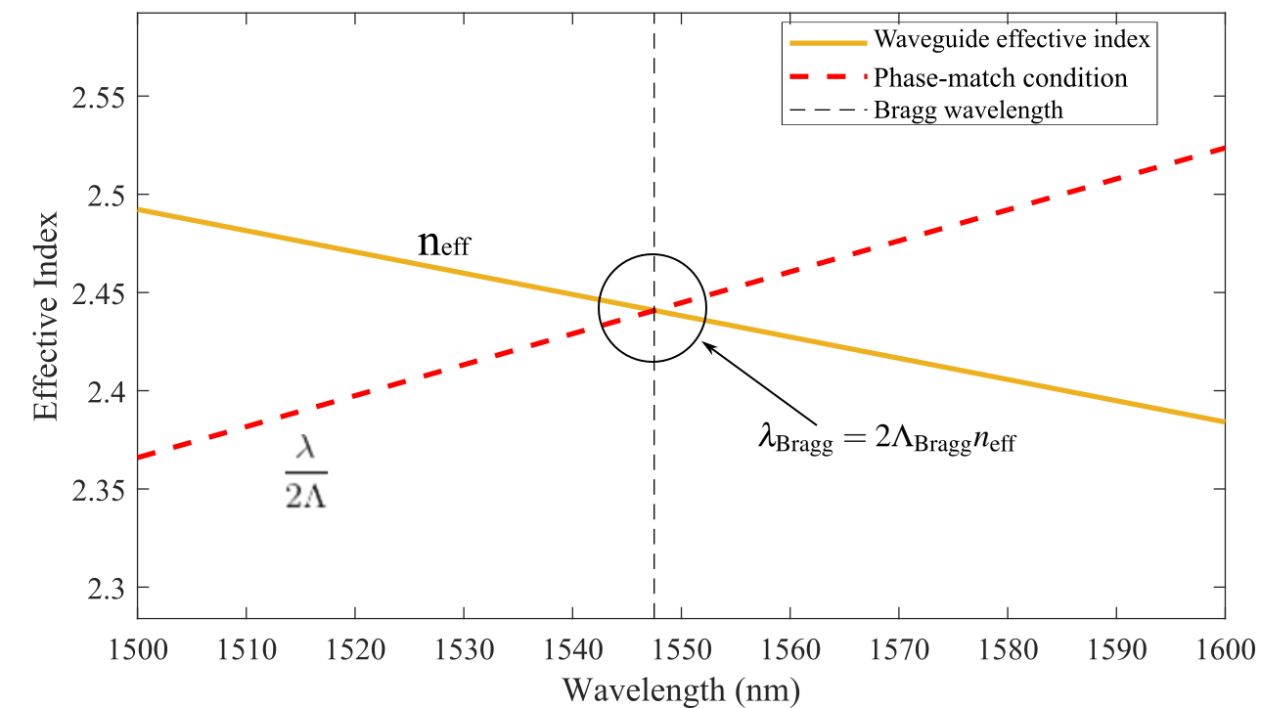
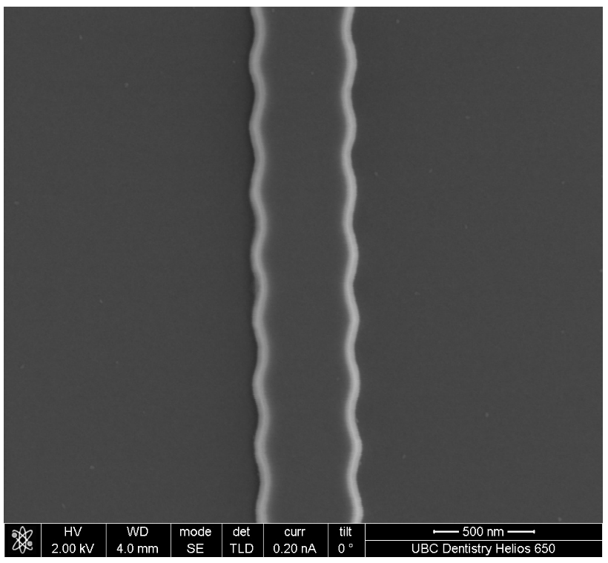
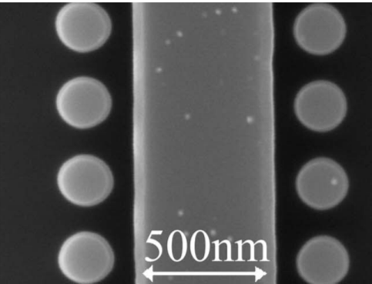
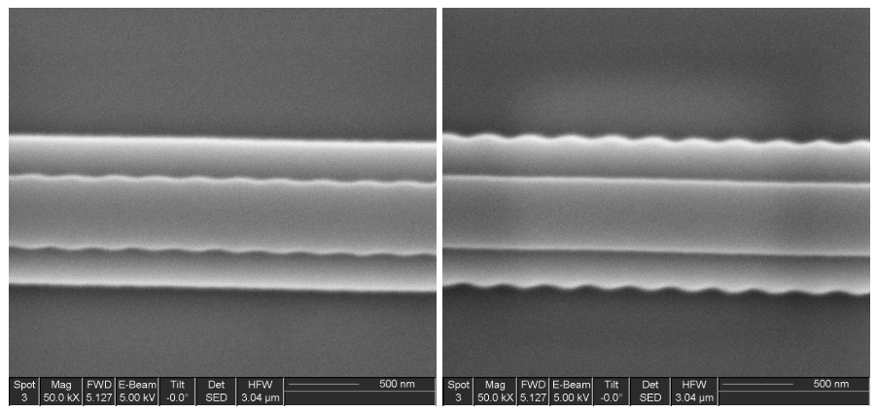
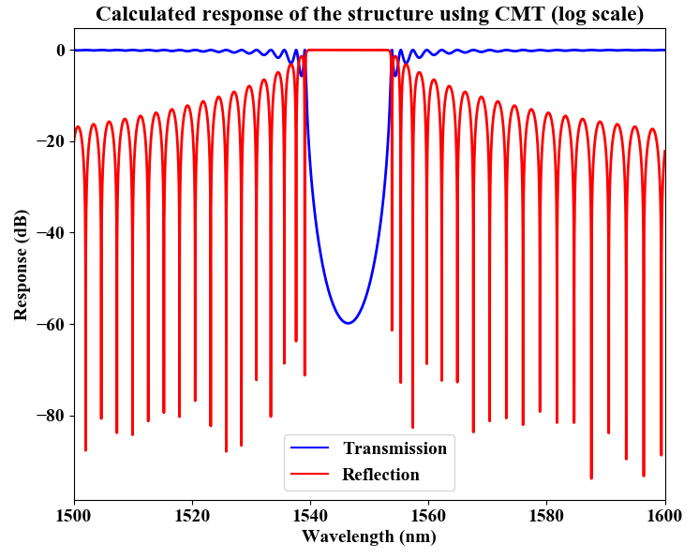
Bragg Gratings: Transfer-Matrix Method
Periodically perturbed waveguides
Side-wall modulation (rib or strip waveguides)
Cladding modulation
Vertical modulation
Applications:
Dispersion compensation
Narrow-band filters
Wide-band filters
Filtered wavelengths are
reflected back to the input port.
A circulator/isolator is
needed!

Slide 5
Bragg Gratings: Transfer-Matrix Method
Available: https://github.com/mustafacc/SiEPIC_Photonics_Package/blob/master/SiEPIC_Photonics_Package/solvers_simulators/bragg_tmm/bragg_tmm.py
Handy tool to quickly model phase-shifted Bragg gratings
Inputs:
Waveguides compact models (effective indices fits, n(λ) )
Period
Number of corrugations
Perturbation size
Advantages:
Quick and simple
Does not scale up with the length of the device
Can simulate complex device profiles (apodized, chirped, etc.)
Disadvantages:
Must have data to fit the coupling coefficient profile vs perturbation size!

Slide 6
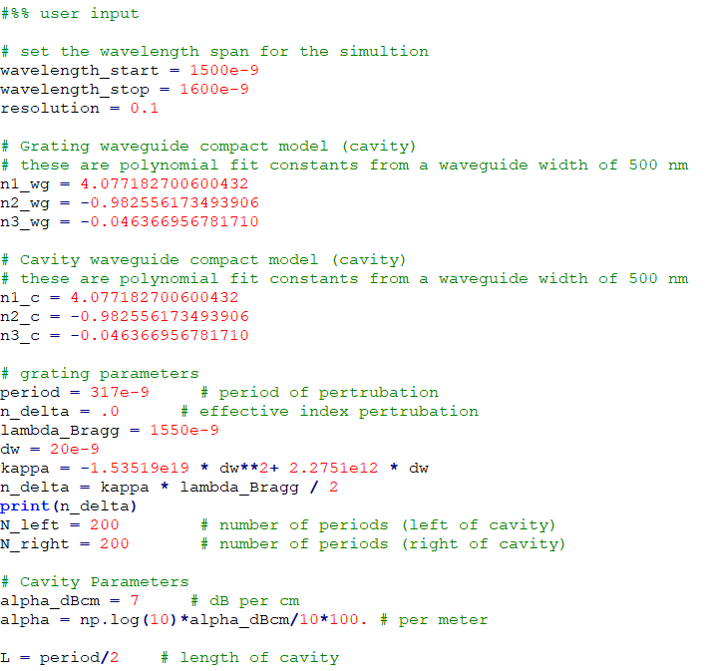
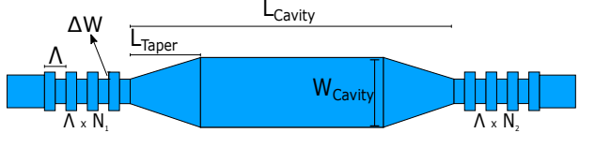
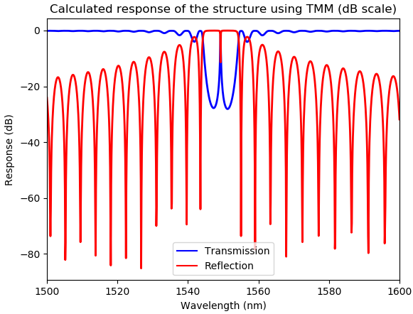
Bragg Gratings: Transfer-Matrix Method
Run bragg_tmm.py

Slide 7
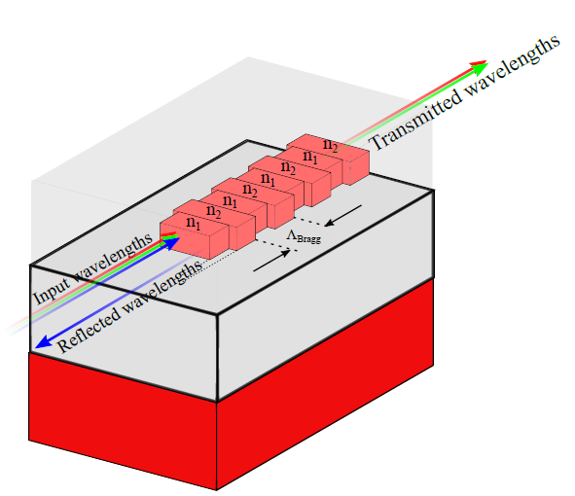
Bragg Gratings: Coupled-mode Theory
Available: https://github.com/mustafacc/SiEPIC_Photonics_Package/blob/master/SiEPIC_Photonics_Package/solvers_simulators/bragg_cmt/bragg_cmt.py
Handy tool to quickly model phase-shifted Bragg gratings
Inputs:
Waveguides compact models (effective indices fits, n(λ) )
Period
Number of corrugations
Coupling coefficient (kappa)
Advantages:
Accurate, less accurate for large perturbations
Not computationally intensive
Disadvantages:
Must have a real value for the coupling coefficient!

Slide 8
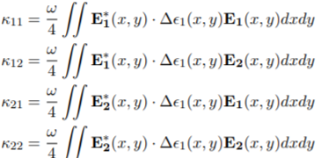
Bragg Gratings: Coupled-mode Theory
Dependent on the waveguides geometry and structure of the perturbation gratings (strength/shape)
Determines the bandwidth and reflectivity of the device
The key parameter that sets coupled-mode theory model to work.
Accurate for small perturbations
Easily implemented for simple
perturbations
Difficult to find the Fourier-expansion term (Δε) for unconventional perturbations shapes (ex: sinusoidal or litho. smoothed corrugations)

Slide 9
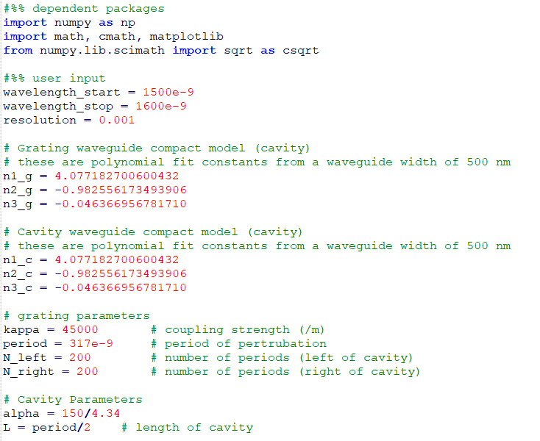
Bragg Gratings: Coupled-mode Theory
Run bragg_cmt.py

Slide 10
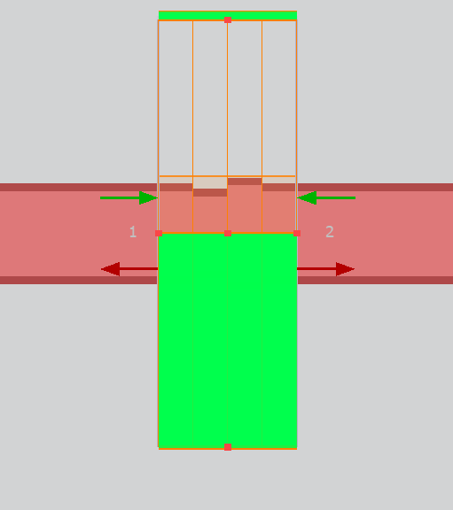
Bragg Gratings: EME
Uses the EME method:
Explained: https://apps.lumerical.com/pic_passive_bragg_full_device_simulation_with_eme.html
Video tutorial: https://www.lumerical.com/support/video/waveguide-bragg-gratings-res.html
Advantages:
Does not need information other than the physical geometry of the device
Relatively fast simulation time compared to FDTD
Disadvantages:
Simulation time scales up with the complexity of the profile
Simulation time scales up with the number of simulation modes required to simulate the device
Less accurate than FDTD simulations

Slide 11
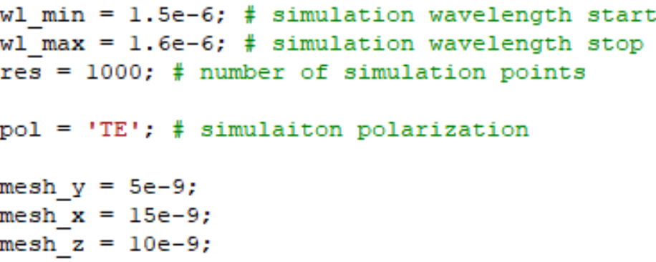
Bragg Gratings: EME
How to:
Download the scripts (Bragg_EME.zip) and open a blank MODE project
With the new MODE project, load the script MAIN_EME.lsf
Adjust the simulation parameters to your needs (wavelength range, polarization, mesh accuracy or leave as default)

Slide 12
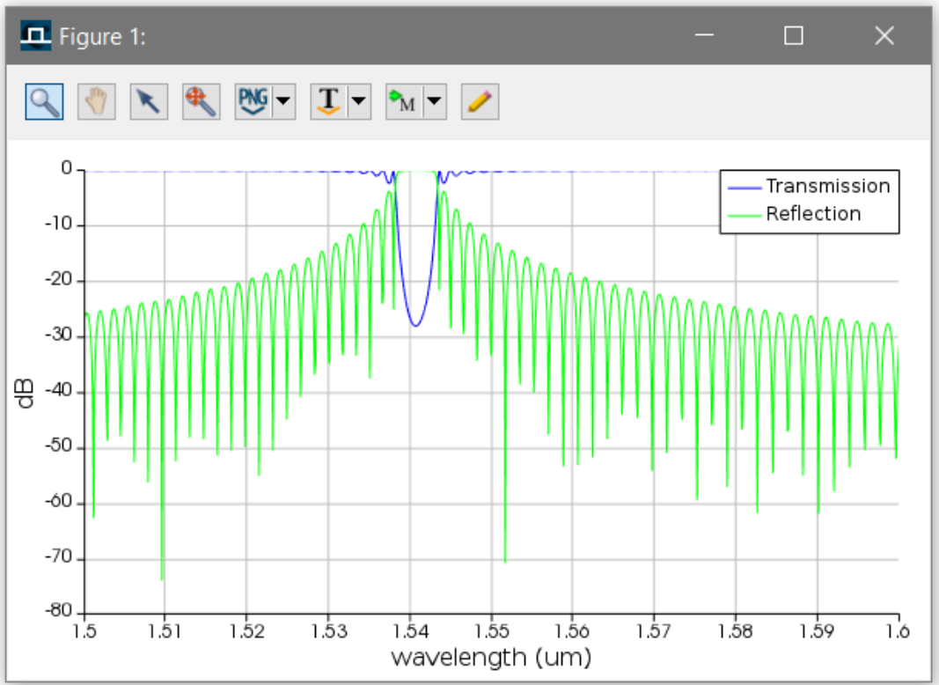
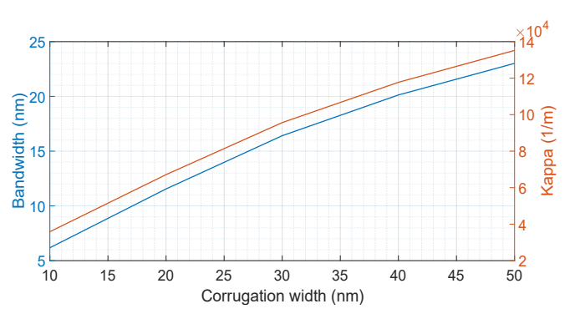
Bragg Gratings: EME
How to:
The script will plot the transmission and reflection spectra, and then extract the 3-dB bandwidth and central wavelength (for your future Kappa analysis).

Slide 13
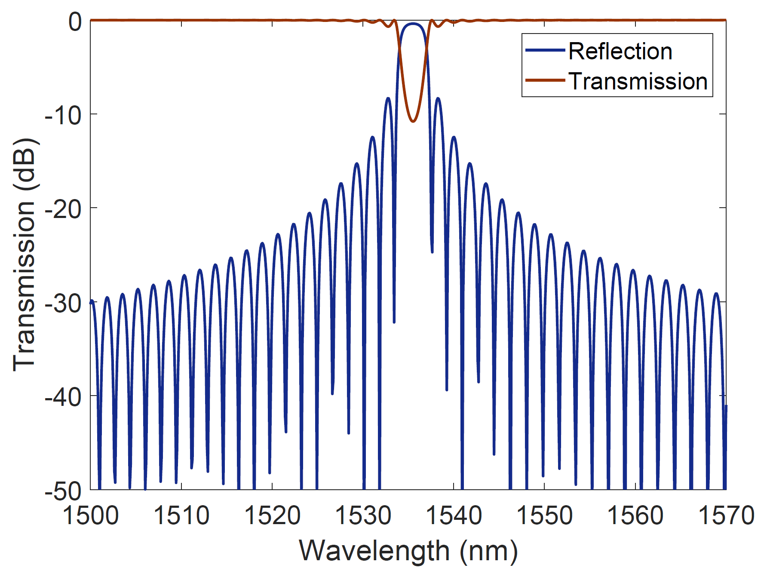
Bragg Gratings: EME
How to:
The script will plot the transmission and reflection spectra, and then extract the 3-dB bandwidth and central wavelength (for your future Kappa analysis).
λo
Δλ

Slide 14
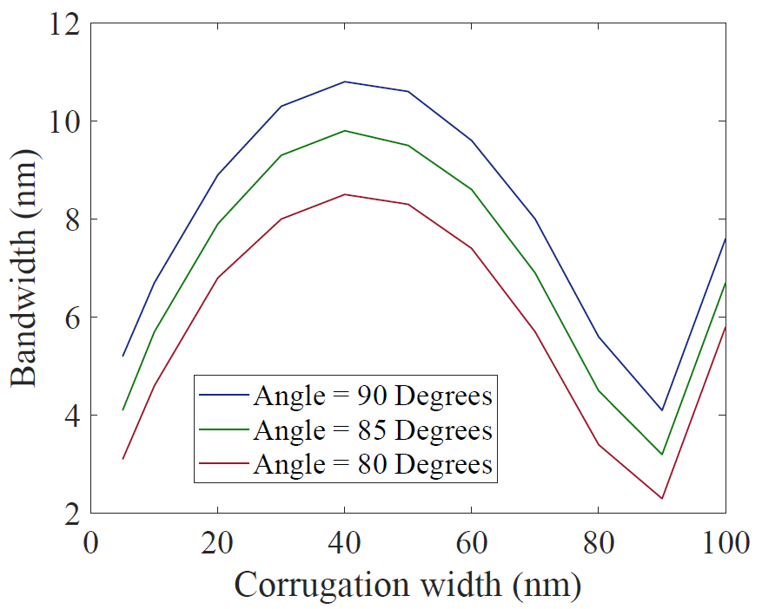
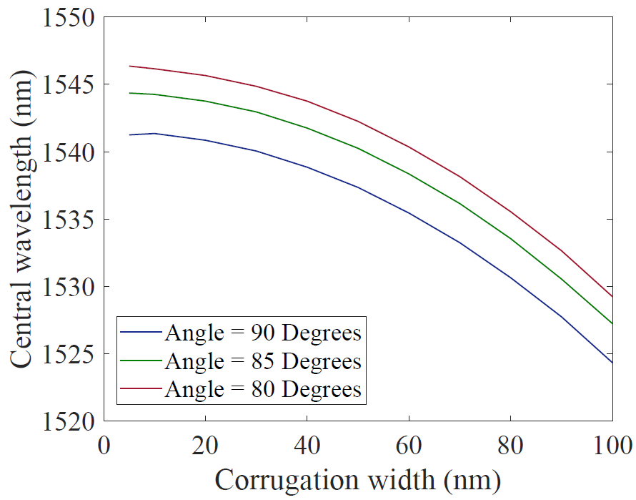
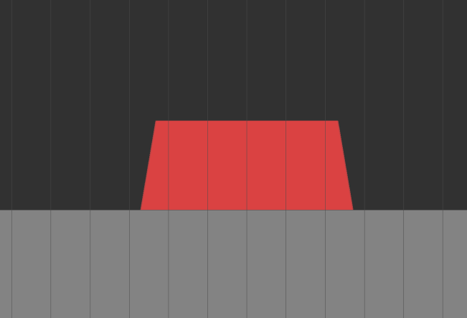
Bragg Gratings: EME
EME simulations can be used to quickly perform parametric studies to understand the effects of specific parameters, i.e. the effects of changing the waveguide’s sidewall angle:
Run applications -> dw_sweep -> MAIN_dw_sweep.lsf

Slide 15
Bragg Gratings: EME
The scripts will force specific settings to improve the simulation speed (e.g., force anti-symmetric boundary conditions when the user specifies the TE polarization) - therefore, if you care more about accuracy rather than speed, you might want to remove these settings from Bragg_simulate.lsf.

Slide 16
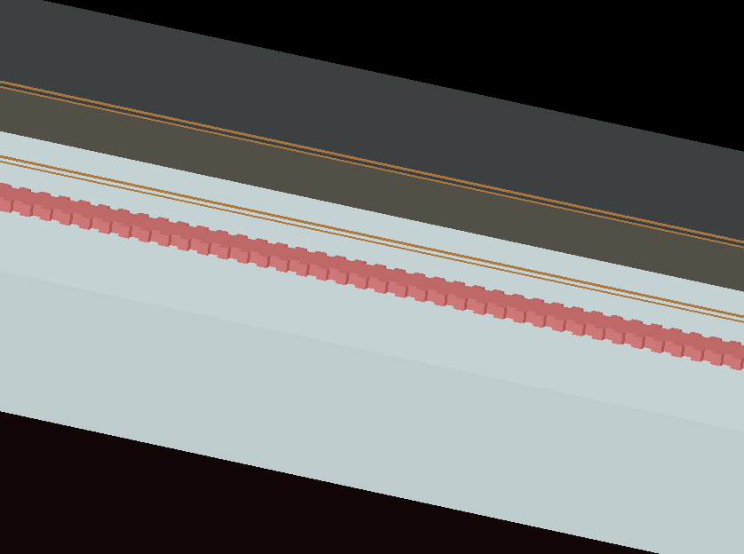
Bragg Gratings: 3D/2D FDTD
Uses FDTD solver:
Simulating the full device length either in 2D FDTD or 3D FDTD
Advantages:
Accurate, if the simulation mesh and time were sufficiently large…
Can be used to simulated complex apodization provide.
Disadvantages:
Very lengthy simulation time!

Slide 17
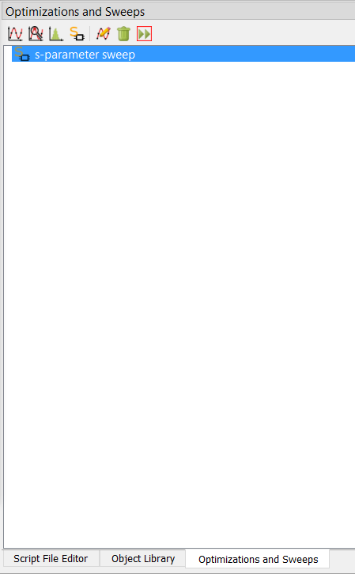
Bragg Gratings: 3D/2D FDTD
Open new FDTD project and load sample code MAIN_FDTD.lsf
Input parameters:
Device physical parameters
Simulation parameters
You can create an S-parameters sweep as well.
You can use ports symmetry.
* There are rarely times you need to actually use 3D FDTD to simulate an entire length of a Bragg grating device. The example is added here for illustrating the inefficiency of the method relative to other methods.

Slide 18
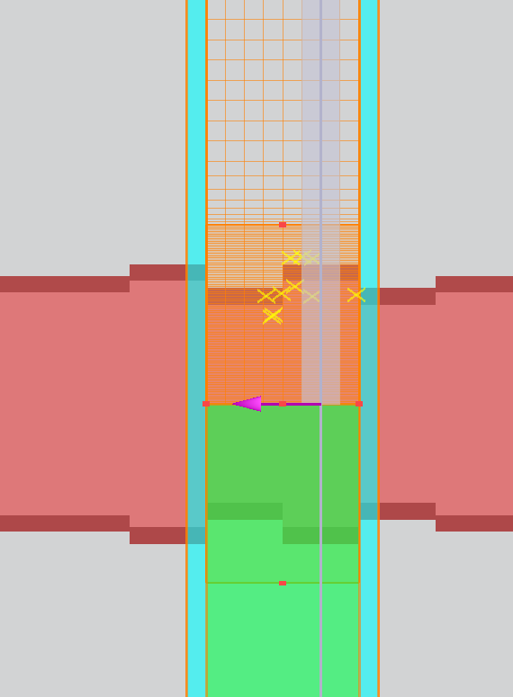
Bragg Gratings: FDTD Bloch Boundary
Uses FDTD solver:
Simulating one unit cell of a grating over an infinite length.
Advantages:
Relatively fast simulation with the most accurate results.
Can be used to perform various parametric sweeps.
Disadvantages:
Cannot simulate the output spectra of advanced apodized devices (directly).
Does not show the output spectra of the device
More at:
https://support.lumerical.com/hc/en-us/articles/360042304394-Bragg-Grating-Initial-Design-with-FDTD

Slide 19
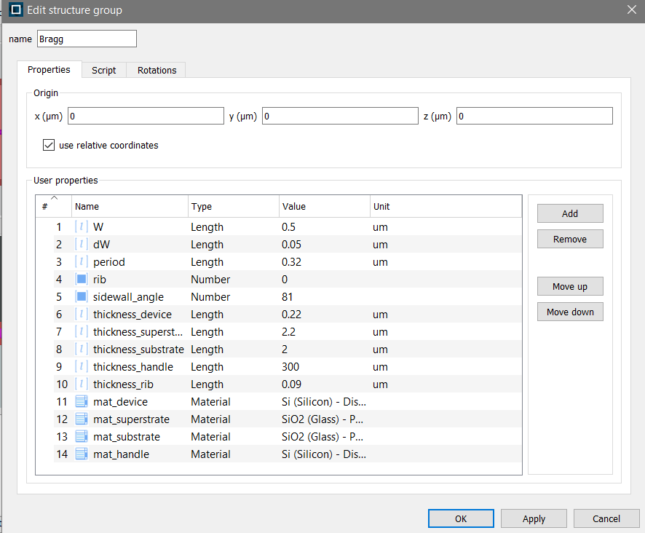
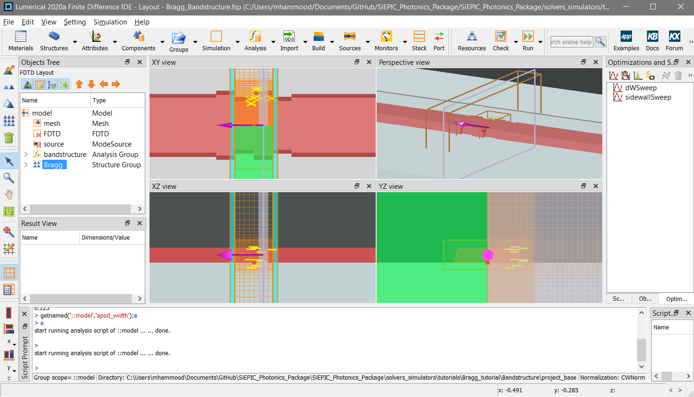
Bragg Gratings: FDTD Bloch Boundary
Two examples provided under ‘Bandstructure’
Script-based: run ‘MAIN_Bandstructure.lsf’ using FDTD script window with simulation and physical parameters. This is a “GUI”-less approach that will setup the simulation for you.
Project-based: open “Bragg_bandstructure.fsp’ using FDTD and configure the simulation settings under “model” and physical settings under “Bragg” objects.
Sample parametric sweeps were setup in this project as an example.

Slide 20
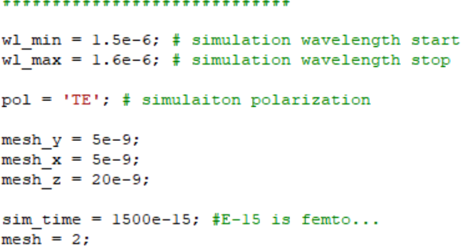
Bragg Gratings: FDTD Bloch Boundary
How to (method 1, script base):
Download the scripts script_base.zip and open a blank FDTD project
From FDTD, load the script MAIN_Bandstructure.lsf
Adjust the simulation parameters to your needs (wavelength range, polarization, mesh accuracy

Slide 21
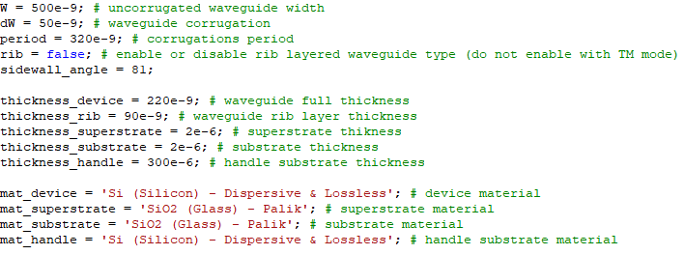
Bragg Gratings: FDTD Bloch Boundary
How to (method 1, script base):
Adjust the device geometry, material, and process stack settings to your needs. Currently the default settings are set for SOI in mind, but it can be changed to any platform.

Slide 22
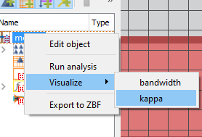
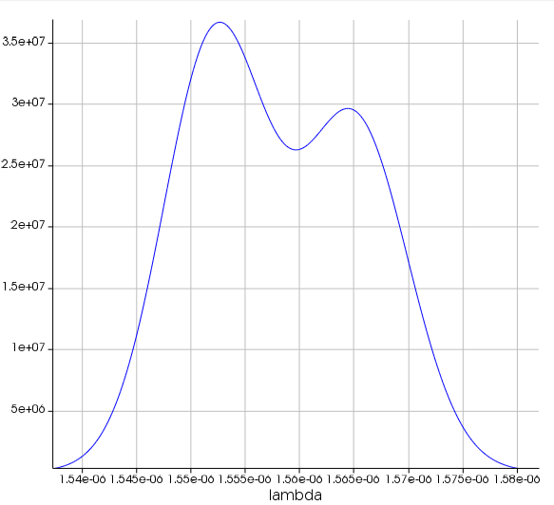
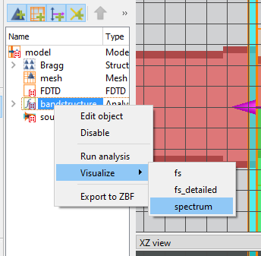
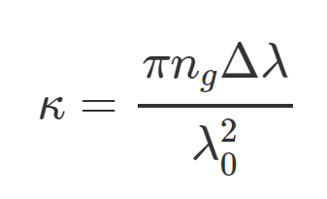
Bragg Gratings: FDTD Bloch Boundary
How to (method 1, script base):
Run the script - given the current settings, it should run in under ~3 minutes.
The script will extract the nulls bandwidth and central wavelength of the Bragg grating, which you can use to extract the Kappa (coupling coefficient) to be used in a coupled-mode theory model.
You can visualize the results
Δλ
λo

Slide 23
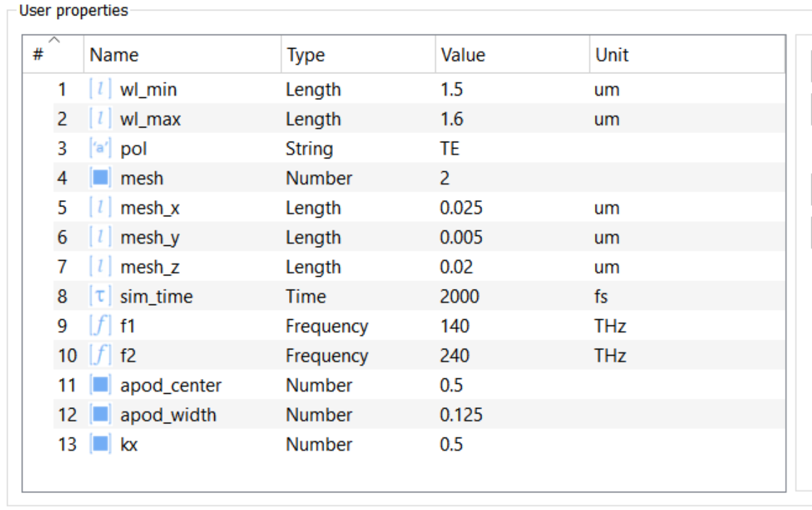
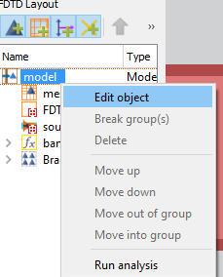
Bragg Gratings: FDTD Bloch Boundary
How to (method 2, project base):
Download the scripts project_base.zip and open Bragg_bandstructure.fsp this is an already setup simulation project.
Right click on Model and edit the simulation settings and parameters to your requirements:

Slide 24
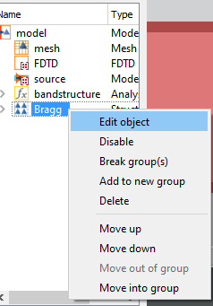
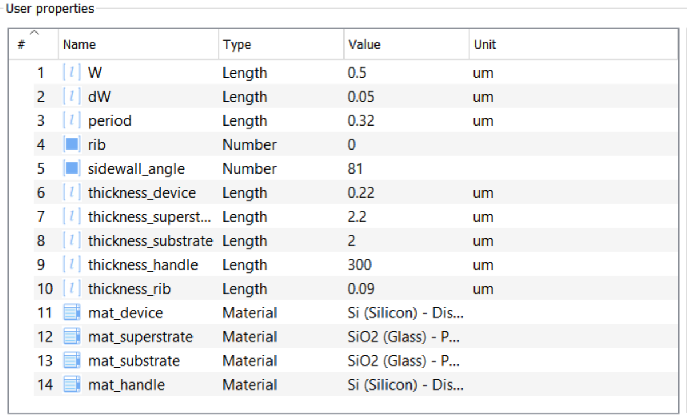
Bragg Gratings: FDTD Bloch Boundary
How to (method 2, project base):
Right click on Bragg structure group and edit the device geometry, material, and process stack.

Slide 25
Bragg Gratings: FDTD Bloch Boundary
How to (method 2, project base):
Run the simulation and let it run. Once the simulation is done you can right click on model and run the analysis to extract the coupling coefficient, bandwidth, and central wavelength of the Bragg grating.
Δλ
λo

Slide 26
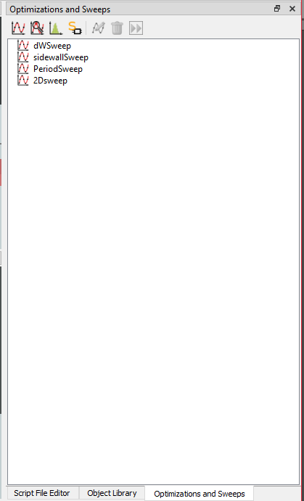
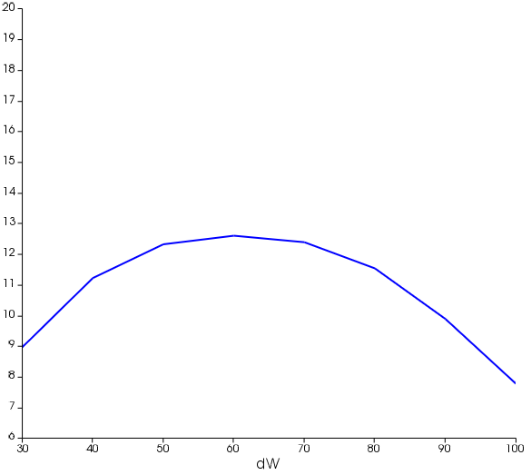
Bragg Gratings: FDTD Bloch Boundary
How to (method 2, project base):
I provided sample parametric sweeps in the optimization and sweeps tab that will help you understand the effects of each of the following parameters:
Perturbation width
Sidewall angle
Bragg Period

Slide 27
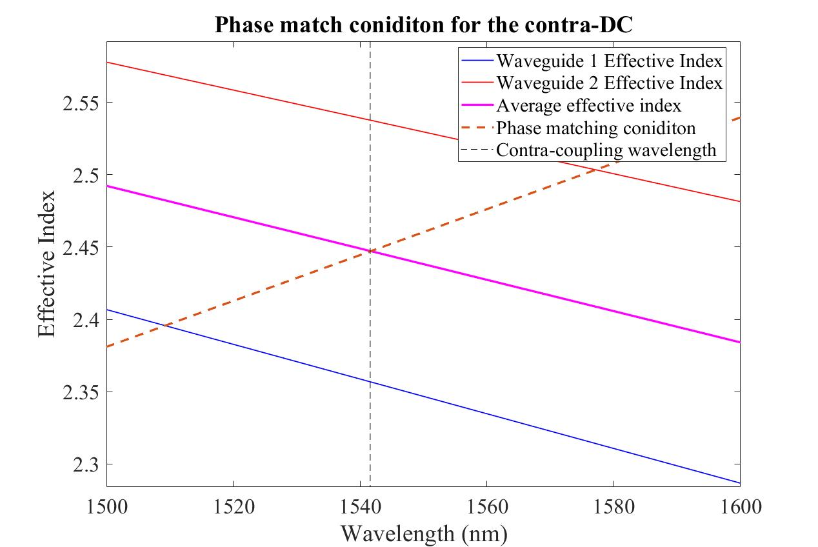
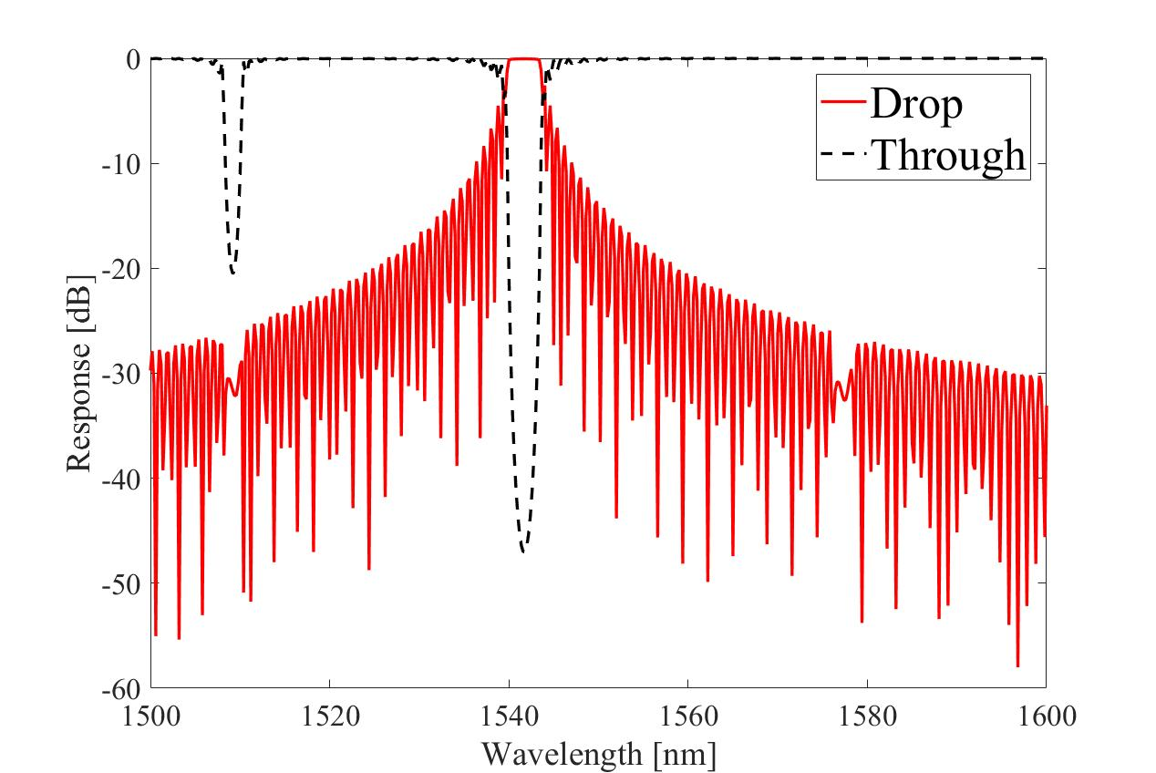
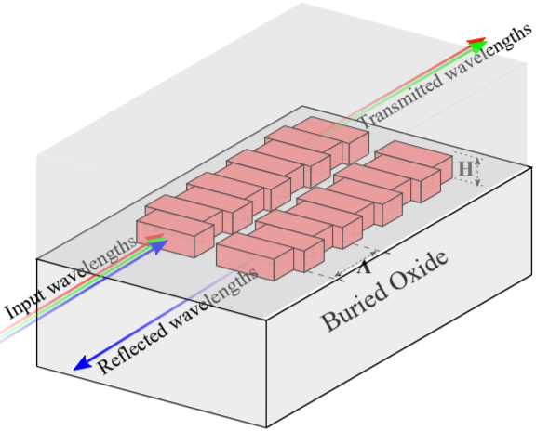
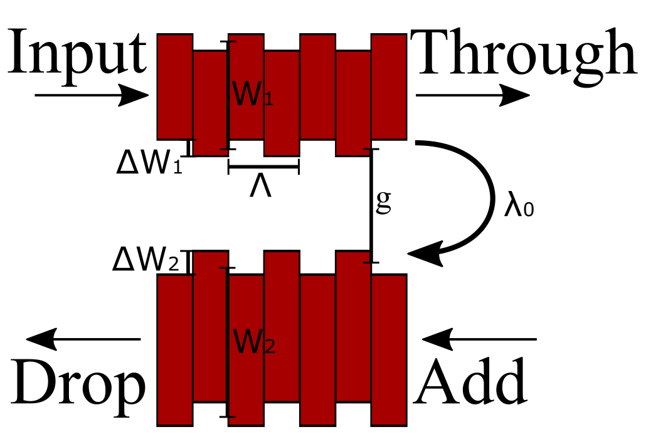
Contra-directional couplers overview
Wavelength-selective coupler
2-Waveguide system, 4-port Device:
Input, through, add, drop
side-walls corrugated, asymmetric waveguides
Light at the phase matched wavelengths couples backwards (contra)
Notes:
Intro. Self reflection

Slide 28
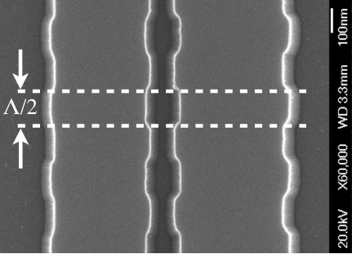
Contra-directional couplers design
Design parameters:
Waveguides widths, corrugations width, waveguides gap, corrugations period apodization profile
Selected design parameters determine the figures of merit:
Bandwidth, central wavelength, band ripple/flatness, crosstalk
Demonstrated on both E-Beam Deep-Ultraviolet (DUV) lithography [3].
Demonstrated on both C-Band and O-Band.
[3] W. Shi, X. Wang, W. Zhang, L. Chrostowski, and N. A. F. Jaeger, “Contradirectional couplers in silicon-on-insulator rib waveguides,” Optics Letters, vol. 36, no. 20, p. 3999, May 2011.
[2]

Slide 29
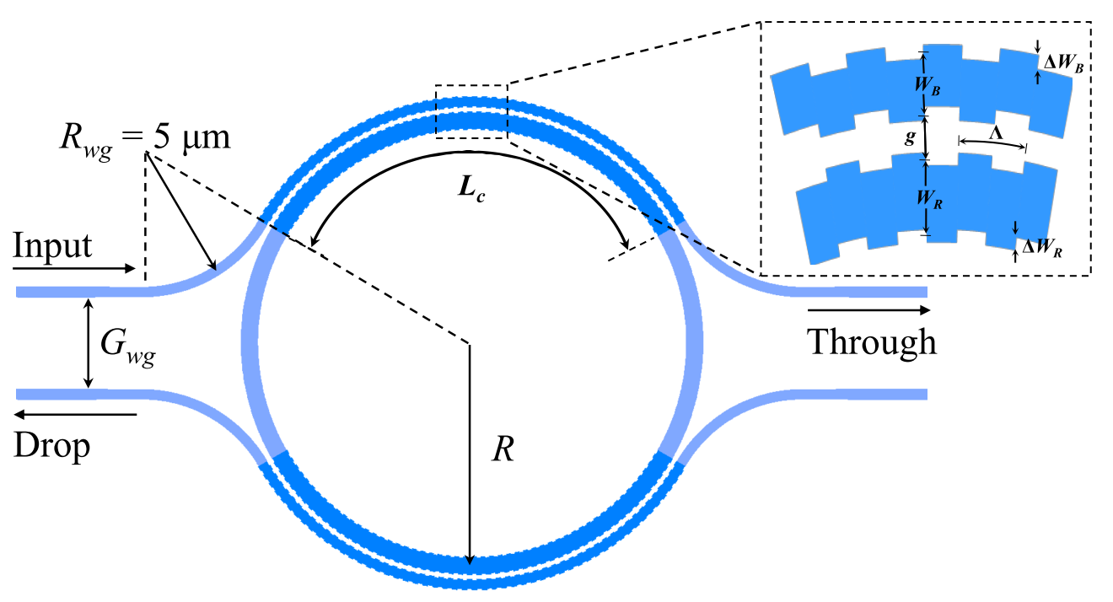
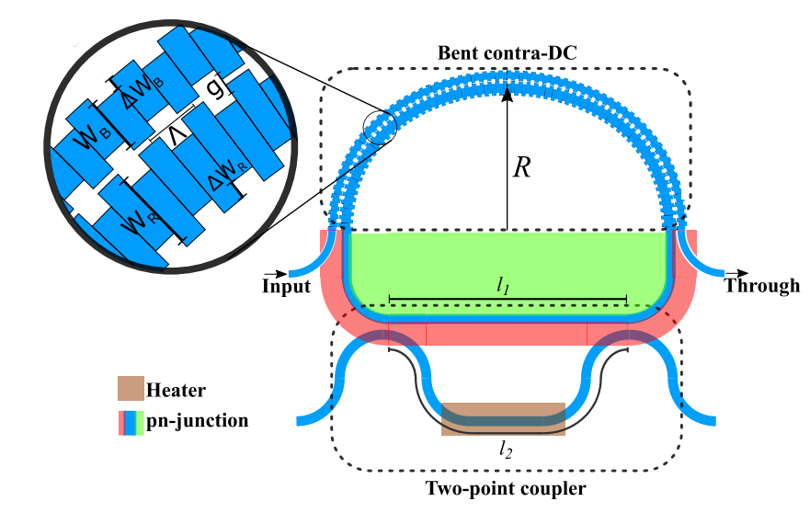
Contra-directional couplers applications
CWDM (de) multiplexers [3]
Free-spectral-range (FSR)-free DWDM (de) multiplexers [4,5]
FSR-free WDM modulators [6]
MDM (de) multiplexers [7]
[3] W. Shi, X. Wang, W. Zhang, L. Chrostowski, and N. A. F. Jaeger, “Contradirectional couplers in silicon-on-insulator rib waveguides,” Optics Letters, vol. 36, no. 20, p. 3999, May 2011.
[4] N. Eid, R. Boeck, H. Jayatilleka, L. Chrostowski, W. Shi, and N. A. F. Jaeger, “A silicon-on-insulator microring resonator filter with bent contradirectional couplers,” 2016 IEEE Photonics Conference (IPC), 2016.
[5] N. Eid, R. Boeck, H. Jayatilleka, L. Chrostowski, W. Shi, and N. A. F. Jaeger, “FSR-free silicon-on-insulator microring resonator based filter with bent contra-directional couplers,” Optics Express, vol. 24, no. 25, p. 29009, Jul. 2016.
[6] A. Mistry, M. Hammood, H. Shoman, L. Chrostowski, N. A. F. Jaeger, “FSR-free microring modulator,” 15th IEEE International Conference on Group IV Photonics, 2018.
[7] X. Zhao, Y. Wang, Q. Huang, and J. Xia, “Two-mode contra-directional coupler based on superposed grating,” Optics Express, vol. 25, no. 3, p. 2654, Jan. 2017.
[3]
[6]

Slide 30
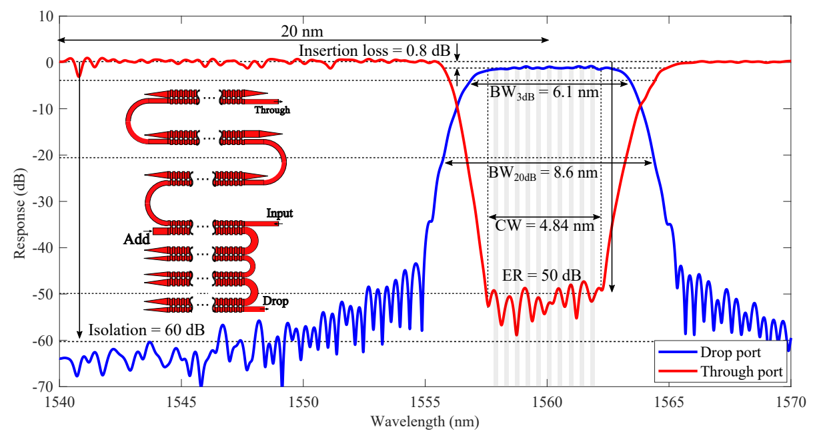
Stacking contra-DCs
Similarly, we can apply the same concept to the Through-port and achieve ultra-high extinction ratio filters

Slide 31
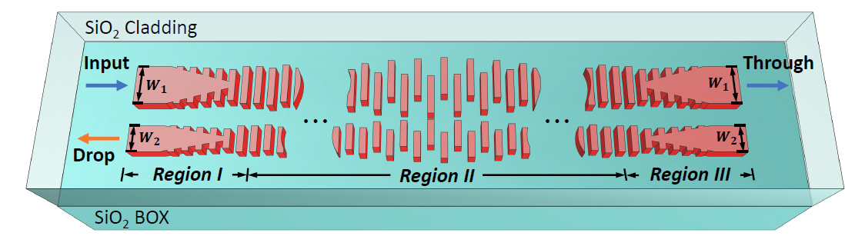
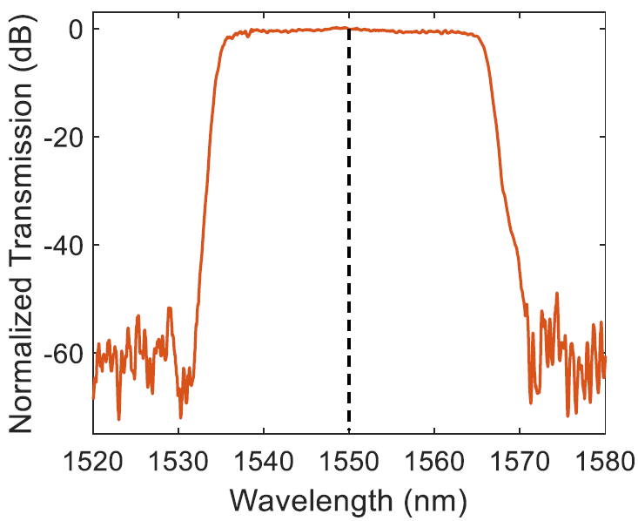
Contra-DC: Sub-wavelength (H. Yun et al. 2019)
Use sub-wavelength waveguides in a contra-DC configuration
Low mode-confinement significantly increases the coupling coefficient
Significantly shorter devices
Wider bandwidths
Insertion loss: 0.86 dB
Bandwidth: up-to 33 nm
Isolation: >55 dB (stacked – 3 stage)
H. Yun et al, OL 2020 - 10.1364/OL.44.004929
Notes:
We can then fabricate these devices for the purpose of designing CWDM systems, as we can see in this example here, where 4 channels, each has its own cascaded levels are used in a single filter. This system is designed for 20nm spacing, 4 channel CWDM systems. This is hopefully the ideal, box-like filter shape that is required for telecom grade filters. It is important to note that all of this is can be made entirely on a very compact footprint with minimal on-chip real-estate, and require absolutely no active thermal tuning.

Slide 32
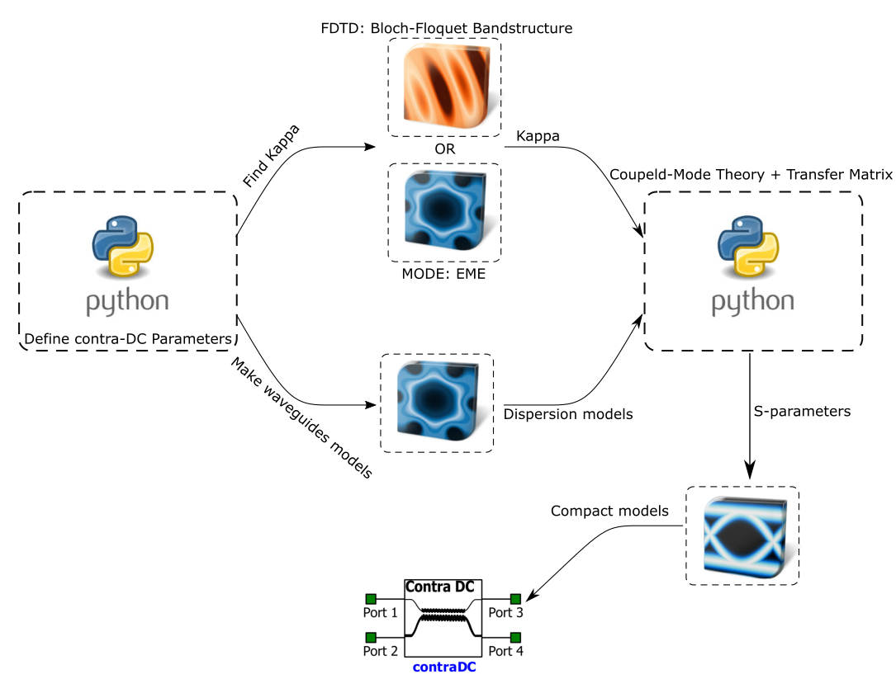
Simulation flow

Slide 33


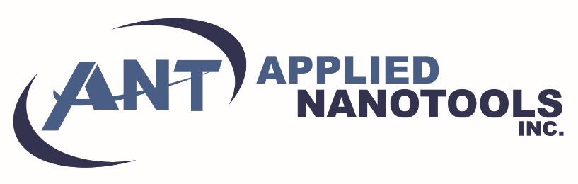




Acknowledgements
Keysight Technologies for their financial support of my projects.
The Natural Sciences and Engineering Research Council (NSERC) of Canada
EBeam Fabrication was done at Applied Nanotools and the University of Washington Microfabrication/Nanotechnology User Facility, a member of the NSF National Nanotechnology Infrastructure Network (NNIN).
Optical lithography was done at the Institute of Microelectronics (IME)/ Advanced Micro Foundry (AMF) at Singapore through Keysight Technologies.
SiEPICfab
Notes:
And this brings me to the end of my presentation. All of this work was possible by these people here, NSERC for providing the support and funding of my degree, keysight for funding the cdc projects and fabrication runs, Applied nanotools, the university of Washington and the NNIN for fabricating the Ebeam chips and supporting the Siepic ebeam pdk. IME, AMF, and the people at CMC for the optical lithography fabrication and their support in developing the SiEPIC IME and AMF PDKs.

